Slide 1
Recurrent Neural Networks and Long Short-term Memory
2018年春节学期
王津
2018-6-28

Slide 2
Outline
Statistic Natural Language Processing and Language Model
Text Classification
Features
Bag-of-Words (BoW)
Word2vec and GloVe
Models
Convolutional Neural Networks
Recurrent Neural Networks
Long Short-Term Memory
Programming tasks
RNN、CNN and LSTM

Slide 3
Statistic Natural Language Processing
How to understand natural language by a computer?
Grammar Rules
Part of Speech
Morphologic
E.g. “徐志摩喜欢林徽因。”

Slide 4
Statistic Language Model
Re-write Rules:
句子->主语 谓语 句号
主语->名词
谓语->动词 名词短语
名词短语->名词
名词->徐志摩
动词->喜欢
名词->林徽因
句号->。

Slide 5
Statistic Language Model
The rule-based model is complex and hard to use
E.g.
美联储主席本.伯南克昨天告诉媒体7000亿美元的救助资金将借给上百家银行、保险公司和汽车公司。
Rule
主语[美联储主席本.伯南克]
动词短语[昨天告诉媒体7000亿美元的救助资金将借给上百家银行、保险公司和汽车公司]
句号[。]

Slide 6
Statistic Language Model
For a doctor who study English over ten years would still hard to cover the whole English grammar.
To create complex rules system for natural language processing is a stupid way.
Context dependent Grammar
Context independent Grammar

Slide 7
Statistic Language Model
Context Dependent Grammar
E.g.
美联储主席本.伯南克昨天告诉媒体7000亿美元的救助资金将借给上百家银行、保险公司和汽车公司。
Re-order
本.伯南克美联储主席昨天7000亿美元的救助资金告诉媒体将借给银行、保险公司和汽车公司上百家。
Confusion
联主美储席本.伯诉体南将借天的救克告媒昨助资金70元亿00美给上百百百家银保行、汽车险公司公司和。

Slide 8
Statistic Language Model
The probability of sentence 1: 10⁻²⁰
The probability of sentence 2: 10⁻²⁵
The probability of sentence 3: 10⁻⁷⁰
Given S as a meaningful sentence, the words in S can be defined as w₁, w₂, …, w_{n}.
The grammar in English will be turned to a statistic problem to calculate the probability of P(S), defined as,

Slide 9
Statistic Language Model
According to Markov process, the word w_{i} are only related to the word w_{i-1}. This statistic language model was called as Bigram model
Unigram model
Trigram model
N-gram model

Slide 10
Statistic Language Model
In a large corpus,
According to the law of large number (大数定理)：
Then, above equation can be transform to,

Slide 11
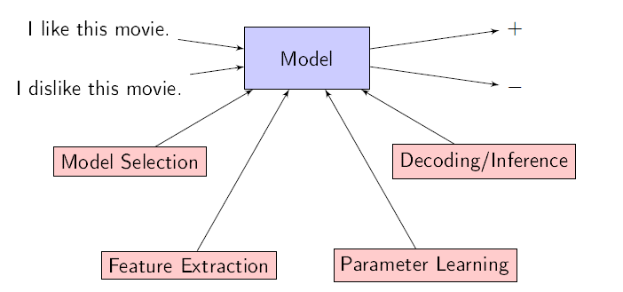
Text Classification
The idea pipeline of NLP

Slide 12
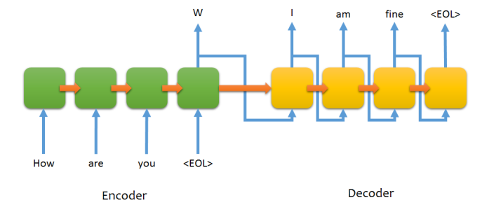
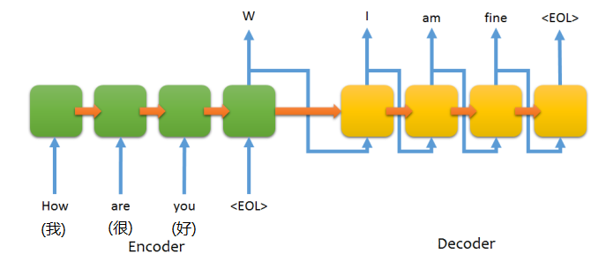
Text Classification
Seq2Seq Learning

Slide 13
Text Classification
Features
Bag-of-Words (BoW)
Word2vec and GloVe
Conventional Models
Random Forest
SVM
Deep Neural Networks
Convolutional Neural Networks
Recurrent Neural Networks
Long Short-Term Memory

Slide 14
Features
Bag of words (BoW)

Slide 15
Features

Slide 16
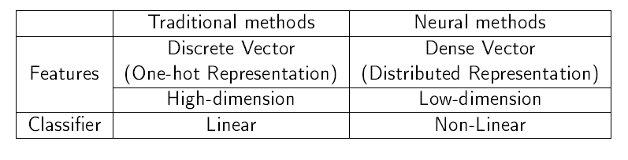
Word Vectors
How to use neural network for the NLP tasks?
Distributed Representation

Slide 17
Word Vectors
Represent the words/features with dense vectors (embeddings) by lookup table
Concatenate the vectors;
Multi-layer neural network
Classification
Regression
Matching
Ranking

Slide 18
Neural Probabilistic Language Model
turn unsupervised learning into supervised learning;
avoid the data sparsity of n-gram model;
project each word into a low dimensional space.

Slide 19
Problem of Very Large Vocabulary
Softmax output:
Unfortunately both evaluating and computing the corresponding likelihood gradient requires normalizing over the entire vocabulary
Hierarchical Softmax: a tree-structured vocabulary
Negative Sampling: noise-contrastive estimation

Slide 20
Word2vec

Slide 21
Word2vec
Given a pair of words (w, c), the probability that the word w is observed in context of the target word w is given by
Where w and c are embeddings vectors of w and c respectively.
The probability of not observing word w in context of word w is given by,

Slide 22
Word2vec
Given a training set D, the word embeddings are learned by maximizing the following objective function:
Where the set D’ is randomly sampled negative examples, assuming they are all incorrect.

Slide 23
Word2vec

Slide 24
Convolutional Neural Network (CNN)
Input: A sentence of length n,
After lookup layer, X = [x₁, x₂, …, x_{n}]

Slide 25
Convolutional Neural Network (CNN)

Slide 26
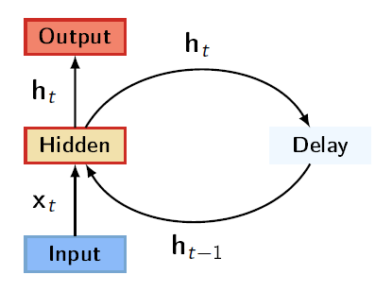
Recurrent Neural Network (RNN)
The RNN has recurrent hidden states whose output at each time is dependent on that of the previous time. More formally, given a sequence x^{(1:n)} = (x⁽¹⁾, …, x^{(t)}, …, x^{(n)}), the RNN updates its recurrent hidden state h^{(t)} by

Slide 27
Recurrent Neural Network (RNN)
f(.) is a non-linear activation function

Slide 28
Recurrent Neural Network (RNN)

Slide 29
Long-Short Term Memory (LSTM)
The core of the LSTM model is a memory cell c encoding memory at every time step of what inputs have been observed up to this step.
The behavior of the cell is controlled by three “gates”:

Slide 30
Long-Short Term Memory (LSTM)

Slide 31

Programming Task
IMDB sentiment analysis
https://www.kaggle.com/c/word2vec-nlp-tutorial/
Give a movie review, classified it into either Positive or Negative.

Slide 32
Pre-process data
Load data
train = pd.read_csv(os.path.join("data", "labeledTrainData.tsv"), header=0,
delimiter="\t", quoting=3)
test = pd.read_csv(os.path.join("data", "testData.tsv"), header=0,
delimiter="\t", quoting=3)
unlabeled_train = pd.read_csv(os.path.join("data", "unlabeledTrainData.tsv"),
header=0,delimiter="\t", quoting=3)

Slide 33
Pre-process data
Data clean
def review_to_wordlist(review, remove_stopwords=False):
# 1. Remove HTML
review_text = BeautifulSoup(review, "lxml").get_text()
#
# 2. Remove non-letters
review_text = re.sub("[^a-zA-Z]"," ", review_text)
#
# 3. Convert words to lower case and split them
words = review_text.lower().split()
# 4. Optionally remove stop words (false by default)
if remove_stopwords:
stops = set(stopwords.words("english"))
words = [w for w in words if not w in stops]
# 5. Return a list of words
return ' '.join(words)

Slide 34
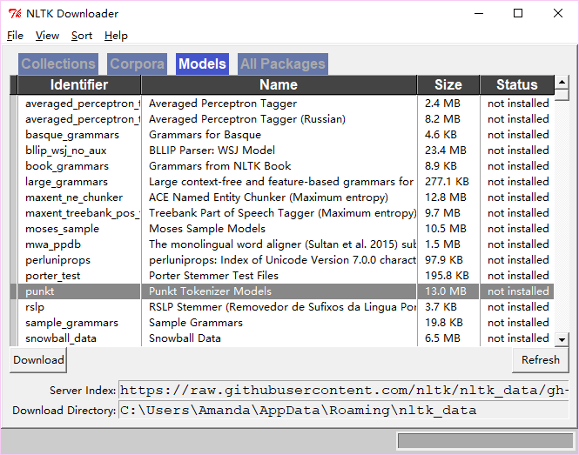
Pre-process data
Down load stopwords list in nltk
Open a console for python and type
import nltk
nltk.download()

Slide 35
Pre-process data
clean_train_reviews = []
for review in train["review"]:
clean_train_reviews.append(review_to_wordlist(review, \
remove_stopwords=True))
clean_test_reviews = []
for review in test["review"]:
clean_test_reviews.append(review_to_wordlist(review, \
remove_stopwords=True))
clean_unlabeled_reviews = []
for view in unlabeled_train["review"]:
clean_unlabeled_reviews.append(review_to_wordlist(review, \
remove_stopwords=True))
y_train = train['sentiment']

Slide 36
Conventional Models
Bag-of-Words
vectorizer = CountVectorizer(analyzer = "word", \
tokenizer = None, \
preprocessor = None, \
stop_words = None, \
max_features = 5000)
train_data_features = vectorizer.fit_transform(clean_train_reviews)
x_train = train_data_features.toarray()

Slide 37
Conventional Models
Test data
Models
test_data_features = vectorizer.transform(clean_test_reviews)
x_test = test_data_features.toarray()
print(x_test.shape)
# svm
from sklearn.svm import SVC
clf = SVC()
save_file = os.path.join('result', 'svm.csv')
# random forest
# from sklearn.ensemble import RandomForestClassifier
# clf = RandomForestClassifier(n_estimators=100)
# save_file = os.path.join('result', 'random_forest.csv')

Slide 38
Conventional Models
Predict
Save results
clf.fit(x_train, y_train)
y_pred = clf.predict(x_test)
save_result(y_pred, save_file)
def save_result(y_pred, file_name):
test = pd.read_csv(os.path.join("data", "testData.tsv"), header=0,
delimiter="\t", quoting=3)
result_df = pd.DataFrame({'id': test["id"], 'Label': y_pred})
result_df.to_csv(file_name, index=False)

Slide 39
Train word2vec models
Turn corpus into sentence lists
import nltk
tokenizer = nltk.data.load('tokenizers/punkt/english.pickle')
def review_to_sentences(review, tokenizer, remove_stopwords=False):
# 1. Use the NLTK tokenizer to split the paragraph into sentences
raw_sentences = tokenizer.tokenize(review.strip())
#
# 2. Loop over each sentence
sentences = []
for raw_sentence in raw_sentences:
# If a sentence is empty, skip it
if len(raw_sentence) > 0:
# Otherwise, call review_to_wordlist to get a list of words
raw_sentence = review_to_wordlist(raw_sentence, remove_stopwords=True)
sentences.append(raw_sentence.split())
return sentences

Slide 40
Train word2vec models
sentences = [] # Initialize an empty list of sentences
for review in train["review"]:
sentences += review_to_sentences(review, tokenizer)
for review in unlabeled_train["review"]:
sentences += review_to_sentences(review, tokenizer)
for review in test["review"]:
sentences += review_to_sentences(review, tokenizer)

Slide 41
Train word2vec models
num_features = 300 # Word vector dimensionality
min_word_count = 40 # Minimum word count
num_workers = 4 # Number of threads to run in parallel
context = 10 # Context window size
downsampling = 1e-3 # Downsample setting for frequent words
from gensim.models import word2vec
print("Training model...")
model = word2vec.Word2Vec(sentences, workers=num_workers, \
size=num_features, min_count = min_word_count, \
window = context, sample = downsampling)
model.init_sims(replace=True)
model_name = os.path.join('vector', "300features_40minwords_10context")
model.save(model_name)

Slide 42
Deep Neural Networks
Transform data
def build_data_train_test(data_train, data_test, train_ratio=0.8):
revs = []
vocab = defaultdict(float)
# Pre-process train data set
for i in range(len(data_train)):
rev = data_train[i]
y = train['sentiment'][i]
orig_rev = ' '.join(rev).lower()
words = set(orig_rev.split())
for word in words:
vocab[word] += 1
datum = {'y': y,
'text': orig_rev,
'num_words': len(orig_rev.split()),
'split': int(np.random.rand() < train_ratio)}
revs.append(datum)

Slide 43
Deep Neural Networks
for i in range(len(data_test)):
rev = data_test[i]
orig_rev = ' '.join(rev).lower()
words = set(orig_rev.split())
for word in words:
vocab[word] += 1
datum = {'y': -1,
'text': orig_rev,
'num_words': len(orig_rev.split()),
'split': -1}
revs.append(datum)
return revs, vocab

Slide 44
Deep Neural Networks
Load Word2vec model
revs, vocab = build_data_train_test(clean_train_reviews, clean_test_reviews)
max_l = np.max(pd.DataFrame(revs)['num_words'])
logging.info('data loaded!')
logging.info('number of sentences: ' + str(len(revs)))
logging.info('vocab size: ' + str(len(vocab)))
logging.info('max sentence length: ' + str(max_l))
# model_file = os.path.join('vector', 'GoogleNews-vectors-negative300.bin')
# model = gensim.models.KeyedVectors.load_word2vec_format(model_file, binary=True)

Slide 45
Deep Neural Networks
Extract word vectors
def load_bin_vec(model, vocab):
word_vecs = {}
unk_words = 0
for word in vocab.keys():
try:
word_vec = model[word]
word_vecs[word] = word_vec
except:
unk_words = unk_words + 1
logging.info('unk words: %d' % (unk_words))
return word_vecs
w2v = load_bin_vec(model, vocab)
logging.info('word embeddings loaded!')
logging.info('num words in embeddings: ' + str(len(w2v)))

Slide 46
Deep Neural Networks
Construct word embeddings
def get_W(word_vecs, k=300):
vocab_size = len(word_vecs)
word_idx_map = dict()
W = np.zeros(shape=(vocab_size+2, k), dtype=np.float32)
W[0] = np.zeros((k, ))
W[1] = np.random.uniform(-0.25, 0.25, k)
i = 2
for word in word_vecs:
W[i] = word_vecs[word]
word_idx_map[word] = i
i = i + 1
return W, word_idx_map
W, word_idx_map = get_W(w2v, k=model.vector_size)
logging.info('extracted index from embeddings! ')

Slide 47
Deep Neural Networks
Save the immediate data
pickle_file = os.path.join('pickle', 'imdb_train_val_test.pickle3')
pickle.dump([revs, W, word_idx_map, vocab, max_l], open(pickle_file, 'wb'))
logging.info('dataset created!')

Slide 48
CNN
Load immediate data
Transforms sentence into a list of indices. Pad with zeroes.
pickle_file = os.path.join('pickle', 'imdb_train_val_test.pickle3')
revs, W, word_idx_map, vocab, maxlen = pickle.load(open(pickle_file, 'rb'))
logging.info('data loaded!')
def get_idx_from_sent(sent, word_idx_map):
x = []
words = sent.split()
for word in words:
if word in word_idx_map:
x.append(word_idx_map[word])
else:
x.append(1)
return x

Slide 49
CNN
Transforms sentences into a 2-d matrix.
def make_idx_data(revs, word_idx_map, maxlen=60):
X_train, X_test, X_dev, y_train, y_dev = [], [], [], [], []
for rev in revs:
sent = get_idx_from_sent(rev['text'], word_idx_map)
y = rev['y']
if rev['split'] == 1:
X_train.append(sent)
y_train.append(y)
elif rev['split'] == 0:
X_dev.append(sent)
y_dev.append(y)
elif rev['split'] == -1:
X_test.append(sent)
X_train = sequence.pad_sequences(np.array(X_train), maxlen=maxlen)
X_dev = sequence.pad_sequences(np.array(X_dev), maxlen=maxlen)
X_test = sequence.pad_sequences(np.array(X_test), maxlen=maxlen)
y_train = np_utils.to_categorical(np.array(y_train))
y_dev = np_utils.to_categorical(np.array(y_dev))
return [X_train, X_test, X_dev, y_train, y_dev]
X_train, X_test, X_dev, y_train, y_dev = make_idx_data(revs, word_idx_map, maxlen=maxlen)

Slide 50
CNN
Model
sequence = Input(shape=(maxlen, ), dtype='int32')
embedded = Embedding(input_dim=max_features, output_dim=num_features, input_length=maxlen, weights=[W], trainable=False) (sequence)
embedded = Dropout(0.25) (embedded)
# convolutional layer
convolution = Convolution1D(filters=nb_filter, kernel_size=kernel_size, padding='valid', activation='relu', strides=1)
(embedded)
maxpooling = MaxPooling1D(pool_size=2) (convolution)
maxpooling = Flatten() (maxpooling)
# We add a vanilla hidden layer:
dense = Dense(70) (maxpooling) # best: 120
dense = Dropout(0.25) (dense) # best: 0.25
dense = Activation('relu') (dense)
output = Dense(2, activation='softmax') (dense)
model = Model(inputs=sequence, outputs=output)
model.compile(loss='categorical_crossentropy', optimizer='adam', metrics=['acc'])

Slide 51
CNN
Training
Predict
model.fit(X_train, y_train, validation_data=[X_dev, y_dev], batch_size=batch_size, epochs=nb_epoch, verbose=2)
y_pred = model.predict(X_test, batch_size=batch_size)
y_pred = np.argmax(y_pred, axis=1)

Slide 52
RNN and LSTM
Model
sequence = Input(shape=(maxlen, ), dtype='int32')
embedded = Embedding(input_dim=max_features, output_dim=num_features, input_length=maxlen, mask_zero=True, weights=[W], trainable=False) (sequence)
embedded = Dropout(0.25) (embedded)
# LSTM
hidden = LSTM(hidden_dim, recurrent_dropout=0.25) (embedded)
# SimpleRNN
# hidden = SimpleRNN(hidden_dim, recurrent_dropout=0.25) (embedded)
output = Dense(2, activation='softmax') (hidden)
model = Model(inputs=sequence, outputs=output)
model.compile(loss='categorical_crossentropy', optimizer='adam', metrics=['acc'])

